Slide 1
Attested Append-Only Memory: Making Adversaries Stick to their Word
SOSP (2007)
Yun-Hsin Kuo, Matthew Farrer

Slide 2
Background
Goals in Distributed Systems are Safety and Liveness
Safety: System reaches agreement on serial ordering of transactions (linearizability)
Liveness: Client eventually receives response to request.
Notes:
Simplify words

Slide 3
Background
Practical Byzantine Fault Tolerance (PBFT) protocol tolerates Byzantine faults, so long as faulty replicas are less than 1 / 3 of total.
One type of Byzantine fault is equivocation.
A2M paper investigates whether a system based on trusted components can tolerate more Byzantine faults.
Goal is to make equivocation extinct or evident.
Notes:
Simplify words

Slide 4



Equivocation
Byzantine generals problem not solvable for 3 parties when 1 is faulty.
Fred!
Joe!
What’s your name?
What’s your name?
Notes:
Explain

Slide 5
Question: Can we solve it if equivocation is not possible?

Slide 6
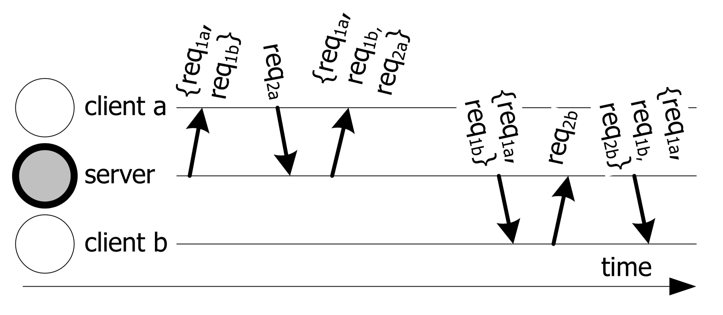
Equivocation to clients

Slide 7
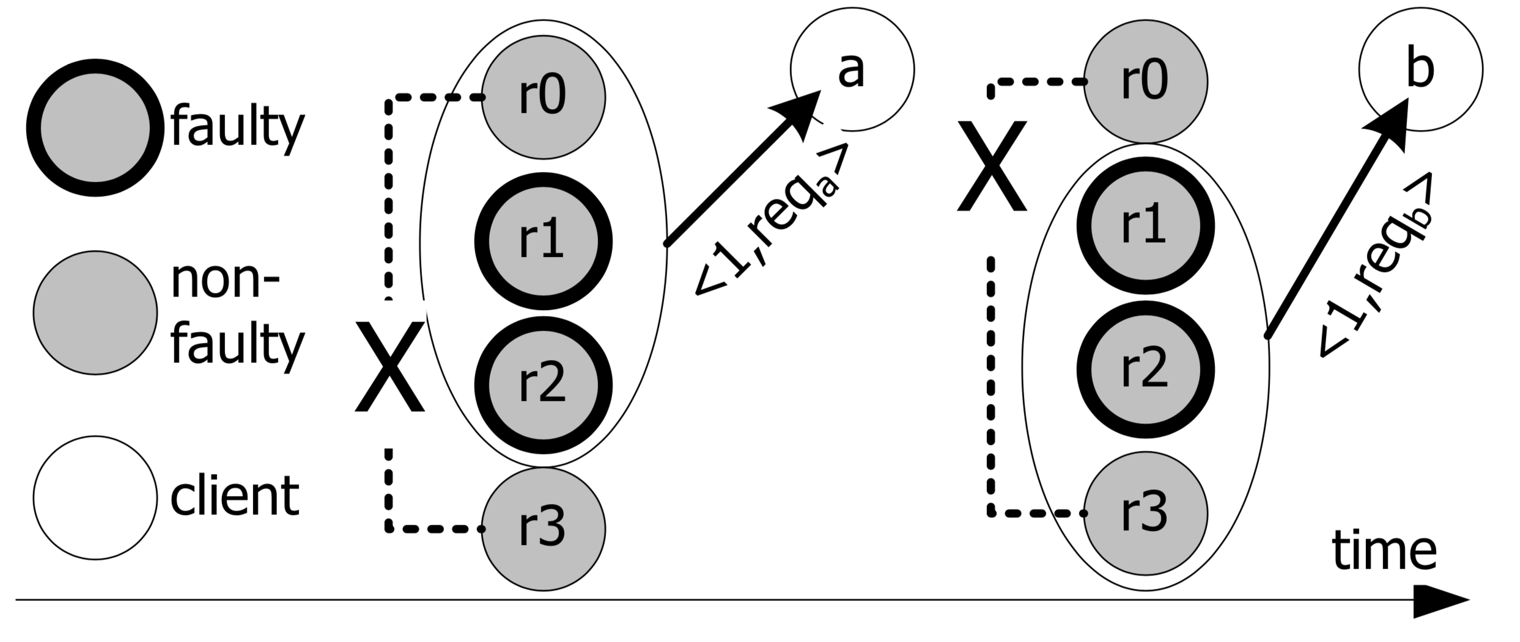
Equivocation to servers
Notes:
This is simple example showing r1 and r2 are “Bad” nodes. If r0 and r3 cannot communicate, then r1 and r2 can convince each of r0 and r3 to commit different states. It follows that they may cause the system to provide different responses to client A and client B.

Slide 8
Attested Append-Only Memory (A2M) Log
Inside a trusted component
Isolated from the rest of system
Provide same response to same query
A2M
q
Authentication
1, x₁, d₁
2, x₂, d₂
Secure Hashing
...
n, x_{n}, d_{n}
Notes:
Attestation later

Slide 9
A2M Interface
A2M
Append(q, x)
Append value x to log q
Advance(q, n, x)
Similar to Append()
Allows log q to skip ahead to n
q
Authentication
1, x₁, d₁
2, x₂, d₂
Secure Hashing
...
9, x₉, d₉
10, x₁₀, d₁₀
Append(q, x = h(msg))
Notes:
Ok and d is digest of previous message? D is cumulative digest

Slide 10
A2M Interface
Lookup(q,n)
Returns Lookup Attestation, <LOOKUP q, n, x>
Tells us what value is present in log q at position n
End(q)
Returns End Attestation, <END q, x>
Last entry of log q
A2M
q
Authentication
1, x₁, d₁
2, x₂, d₂
Secure Hashing
...
<LOOKUP q, n, x_{n}>
n, x_{n}, d_{n}
Lookup(q, n)

Slide 11
A2M Log
Why is this useful?
We can demand that a replica includes A2M attestation with certain messages.
We can compare attestation to message to detect lying.

Slide 12
PBFT Review
Three-phase consensus protocol
Pre-prepare, Prepare, and Commit
In a network with N replicas
Replicas consist of 1 primary and N - 1 backups.
PBFT can tolerate at most faults F = (floor function) (N - 1) / 3 faulty replicas.
I.e., Faults must be less than N / 3
Notes:
I think I will be very brief reviewing PBFT
Cause I don’t want Professor to get mad
Cause that was a previous talk
Can spend more time on benchmarks

Slide 13
PBFT Review
Preprepare
Primary multicasts Pre-prepare message to replicas
Primary appends same message to its log. (Note - this is not the same as an A2M log)
Prepare
Backups multicast Prepare message that matches Pre-prepare message
Appends same to its message log.
A replica is “Prepared” iff it receives a Pre-prepare message and 2F or more matching Prepare messages

Slide 14
PBFT Review
Commit
If a replica is Prepared, it multicasts a Commit message and appends the same to its log
A replica enters Committed state iff it receives 2F + 1 or more commit messages.
Reply
Upon entering Committed state, replica may execute client request and send Reply message to Client
Client waits for F+1 replies with the same result

Slide 15
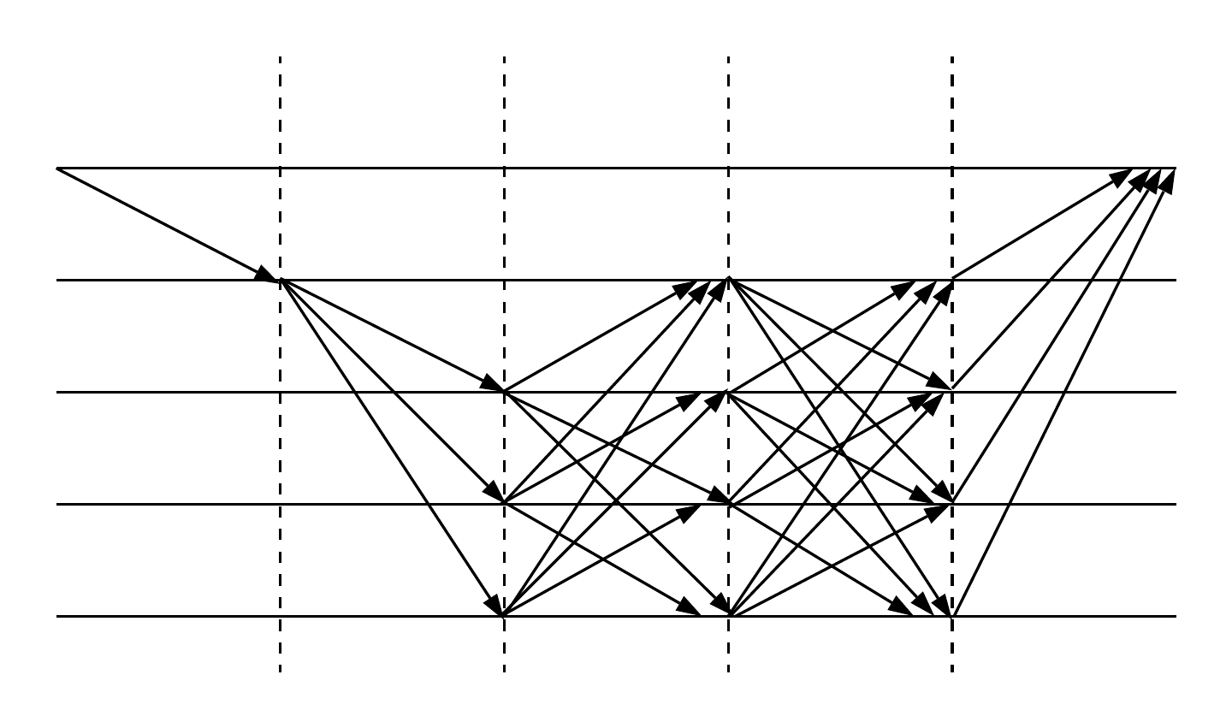
PBFT
Agreement
Execution
Pre- prepare
Request
Prepare
Commit
Reply
Client
Primary
Replica 1
Replica 2
Replica 3
Notes:
https://www.lucidchart.com/invitations/accept/312243d5-4d95-4e7c-bde0-513f44516d11
Primary in PBFT has a special role.
If you want I can draw the scenario here of equivocating to clients
Might be a nice intro for PBFT E

Slide 16
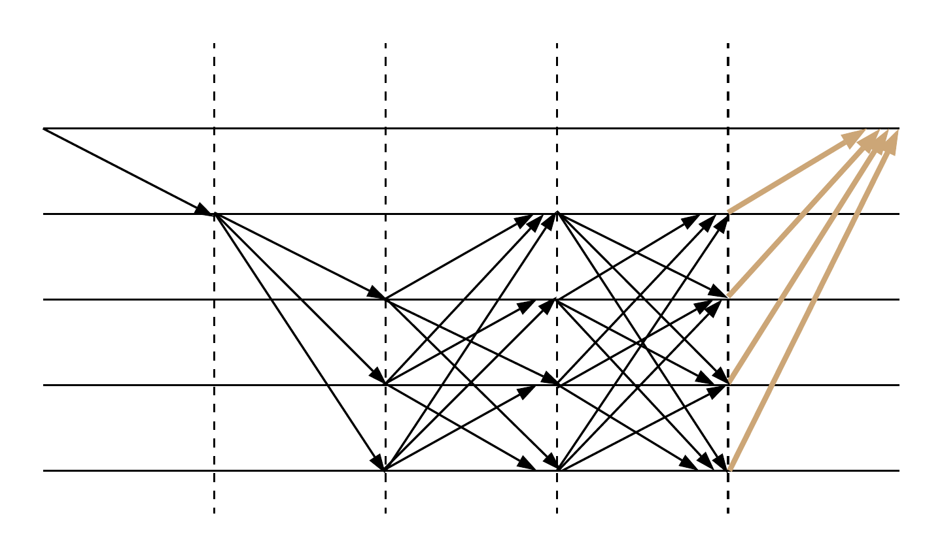
A2M-PBFT-E
Protect the execution portion of PBFT
Equivocation to clients will be detected
One history A2M log serves as the agreed request sequence
Appends Reply messages
Request
Pre- prepare
Prepare
Commit
Reply
Client
Primary
Replica 1
Replica 2
Replica 3
Attested by A2M

Slide 17
A2M-PBFT-E
Execution
A2M₃
Commit
Reply
q
2F+1 replies
Authentication
Client
Primary
Secure Hashing
...
<msg, <LOOKUP>>
Replica 1
n, h(req), d_{n}
Replica 2
<LOOKUP q,n, h(req)>
Replica 3
Append(q, h(req))
Attested by A2M

Slide 18


Prevent Equivocation to client
For every sequence number, all clients accept the same request
Proved by contradiction : clients accept different requests
F+1 non-faulty replicas
For the same sequence number,
But attestations are the same
+1
accepts req1
2F
h(req1) = h(req2)
Due to collision-resistance,
req1 = req2
F
+1
Client 1
2F faults
accepts req2
2F
+1
2F
Client 2
req1 != req2

Slide 19
Linearizability and Liveness
For every sequence number, all clients accept the same request
Linearizability
When no more than ⅓ of total replicas are faulty
Linearizability and Liveness are both guaranteed
Same as PBFT
When more than ⅓, but less than ⅔ of total replicas are faulty
Only Linearizability is guaranteed
Size of 2F+1 reply messages
Equivocation to servers can happen
Divergence in history log

Slide 20
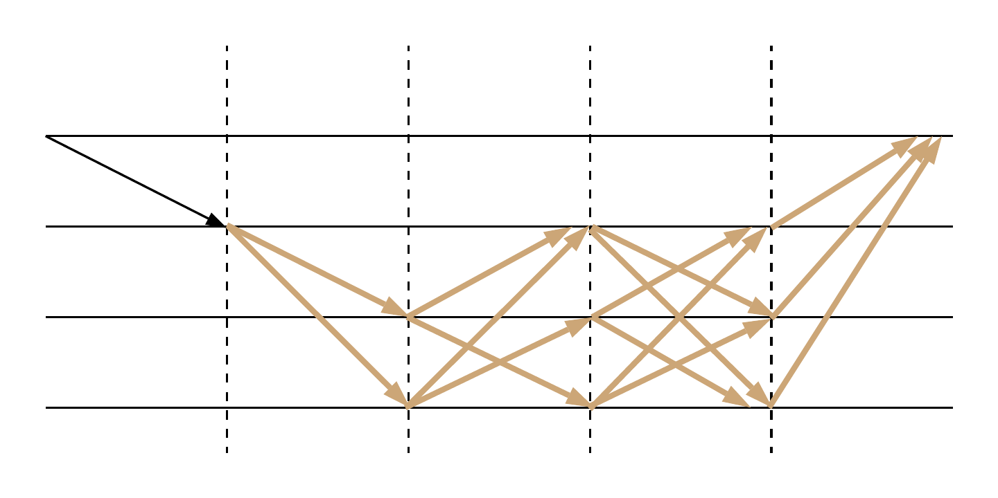
A2M-PBFT-EA
Protects execution and agreement.
Equivocation to clients or replicas will be detected
Agreement
Execution
Pre- prepare
Request
Prepare
Commit
Reply
Client
Primary
Replica 1
Replica 2
Attested by A2M

Slide 21
A2M-PBFT-EA
Appends A2M attestation to all protocol messages
One committed history log
A2M-PBFT-E
Additional message logs to record individual message
e.g., Commit messages have their own message log
Use Advance

Slide 22
A2M-PBFT-EA
F+1 messages in all phases
Agreement
A2M₂
Pre- prepare
Request
Prepare
Commit
Reply
q_{c}
Authentication
Client
Primary
Secure Hashing
...
Replica 1
n, h(req),d_{n}
Replica 2
<msg, <LOOKUP>>
Commit Msg Log
<LOOKUP, q_{c}, n, h(com)>
Advance(q_{c}, n, h(com))
Attested by A2M
Notes:
OK. I think I’ve figured out why this works and tolerates higher faulty nodes.
It relates back to the picture at the start with the three dudes. Suppose Replica2 faults (could be either crash or different message than sent by Primary)
It’s because Primary and Replica1 no longer need Replica2. Preprepare that Replica 1 receives is attested. So if Replica two says something different or doesn’t respond, Replica 1 KNOWS Replica 2 is at fault. As opposed to the case without attestation, Replica 1 can’t tell whether Primary or Replica 2 is faulty. This is kind of a big deal, I think we should say this. It is really the same reasoning as the picture with the three men.
what?
Yea I’m reading 1 more time rt now
Then no more
Protecting equivocation to client is still good
Situation from figure 2 becomes impossible

Slide 23
Linearizability and Liveness
For every sequence number, all non-faulty replicas commit same request
Size of F+1 messages
i.e., single committed request sequence
F+1 non-faulty replicas can tolerate F faults
A primary and two replicas
When no more than ½ of total replicas are faulty
Linearizability and Liveness are both guaranteed
Notes:
By attesting all the messages, all non-faulty replicas commit same request. This proof is similar to the proof in E.
This is the big premise here. To show why we only need F+1 non-faulty replicas.
So the single committed request sequence forms, linearizability is thus guaranteed.
The lamest way to prove liveness is to say in A2M-E the liveness is not guaranteed due to equivocation to servers, but now we prevent both.
So liveness will not be hindered by any malicious attacks. The actual proof covers view change cases, but I don’t want to read it...
The simplest case to reach a consensus is three people. If we have one fault here, as it is ensured that the other two non-faulty will commit the same answer,
The majority forms. That’s it.

Slide 24
Comparison
PBFT
⅓ S & L
A2M-PBFT-E
⅓ Liveness
⅔ Safety
A2M-PBFT-EA
½ Safety & Liveness
Notes:
I thinks its great idea but risky to use same graphic from other slides.
Can’t think of other ways to visualize this stuff.

Slide 25
A2M-Storage
A single untrusted server shared by multiple clients
Improved from SUNDR and is simpler
SUNDR only guarantees fork consistency
Linearizability is guaranteed

Slide 26



SUNDR
Secure Untrusted Data Repository
An untrusted single-server shared by multiple clients
Current state n
Pending operations
SUNDR server
req
State n +
Client 1
Client 2

Slide 27

SUNDR
Secure Untrusted Data Repository
An untrusted single-server shared by multiple clients
Current state n
Pending operations
SUNDR server
State n+1
State n +
State n +
State n+1’
Client 1
Fork consistency
Client 2

Slide 28
A2M-Storage
Timestamp_n
Timestamp_n+1
Current state n+1
Current state n
The server maintain two logs
q_{s}: state version log
q_{h}: request history log
Timestamp = < n, <END q_{s}, n>, <END q_{h}, n>>
Every client knows its latest timestamp
Linearizability
Client only accepts reply with 2 A2M attestations
req, state n+1, timestamp_n
A2M-S server
2 atts,
state n+1 digest
Client 1
Timestamp_n
Timestamp_n-2

Slide 29
Evaluation
Software A2M implementation, i.e., library
A2M-PBFT-E and A2M-PBFT-EA
Authentication: MACs or signatures
Message authentication codes are faster than digital signatures
Microbenchmarks
Involves executing a very small (null) instruction
Macrobenchmarks
Software package compilation instructions executed by replicas. Takes longer

Slide 30
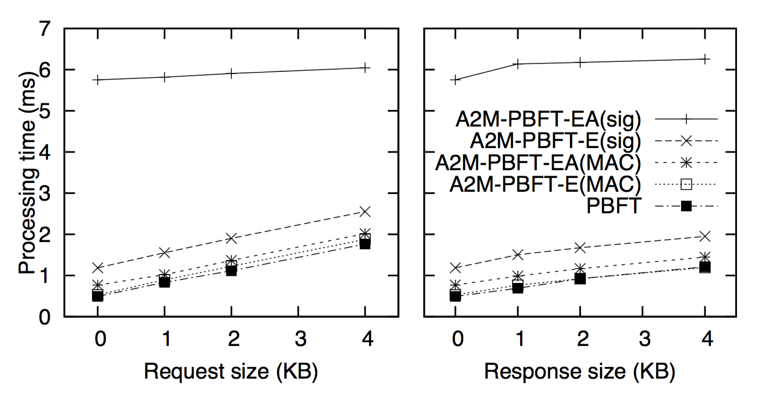
Microbenchmarks
Client sends 100,000 null operations to client
Findings: MAC authentication results in less processing time

Slide 31
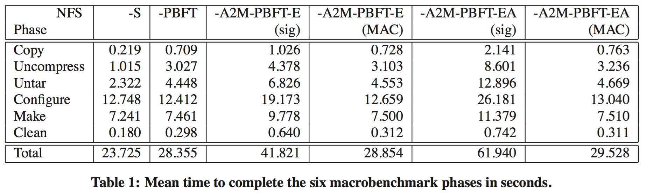
Macrobenchmarks
Software package compilation in NFS
Single server

Slide 32
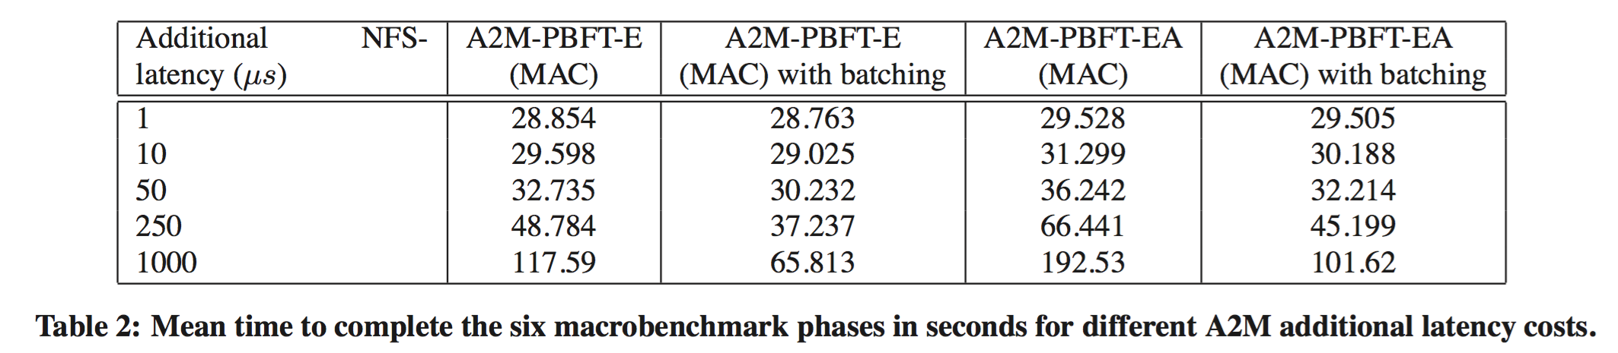
Varying Delay Time
Impose various delays on each A2M request
Batching: bundling Append/Advance with Lookup
Notes:
I think, when it comes to latencies, it is maybe ok to mention the different implementation possibilities, like software library, hardware, VM etc. cause that is the reason they run tests for different latencies

Slide 33
Is A2M the right trusted abstraction?
Key-value pairs may be alternatives?
A2M can cover both replicated and single-server system
Trivial solution: Larger trusted abstraction
e.g. push PBFT into the trusted computing base
Complex implementation

Slide 34
Conclusion
A2M is a trusted log
Easy to implement and only requires small memory
Renders equivocation extinct or evident
Improve the fault tolerance bounds in the distributed system
A2M-PBFT-E and A2M-PBFT-EA
Linearizability achieved in an untrusted single-server system
A2M-Storage
Minor computational overhead

